Slide 1
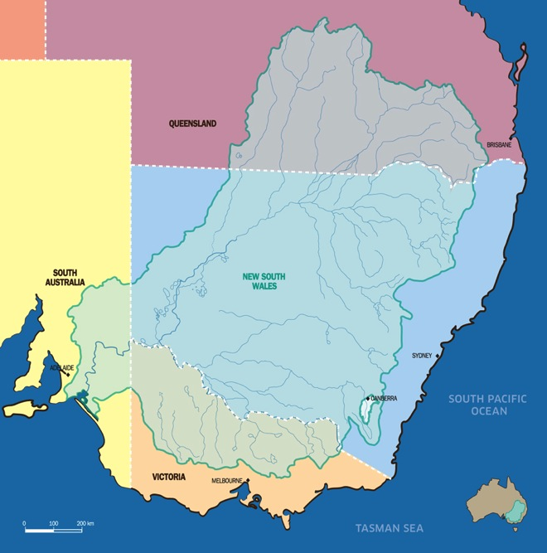
Four states and one territory

Slide 2
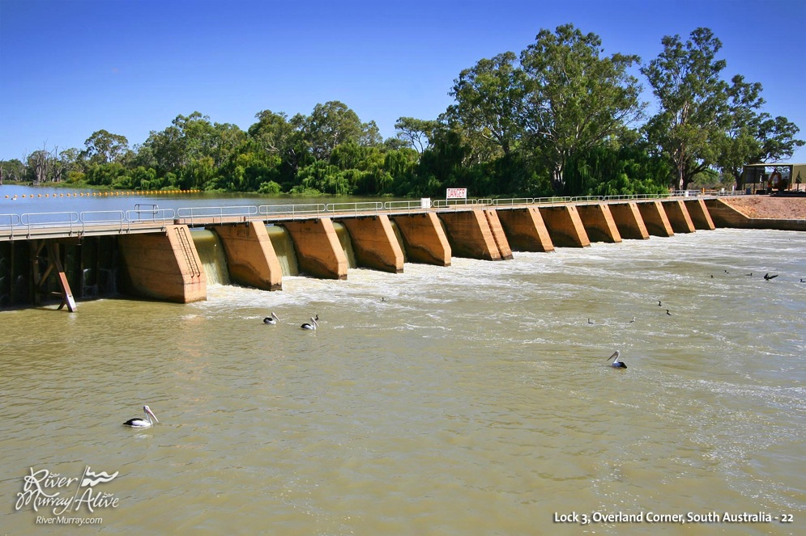
Locks

Slide 3
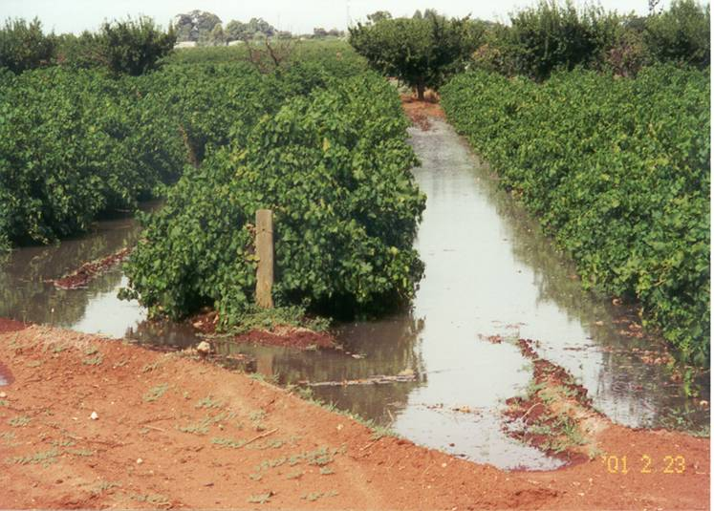
Flood Irrigation

Slide 4
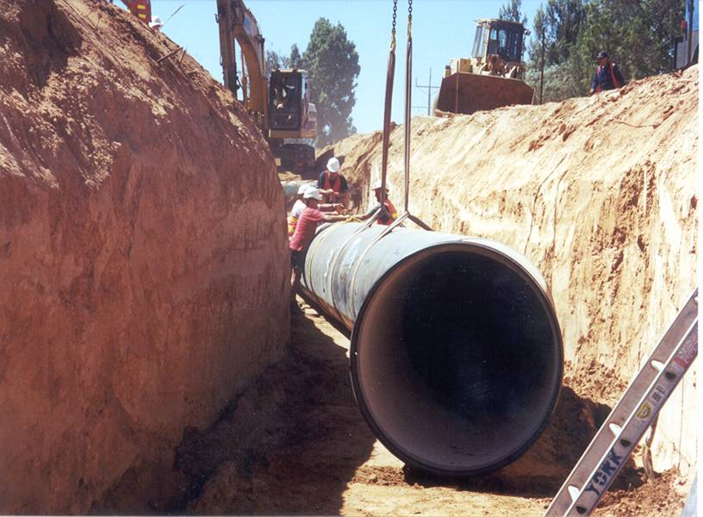
Pipeline Installation

Slide 5
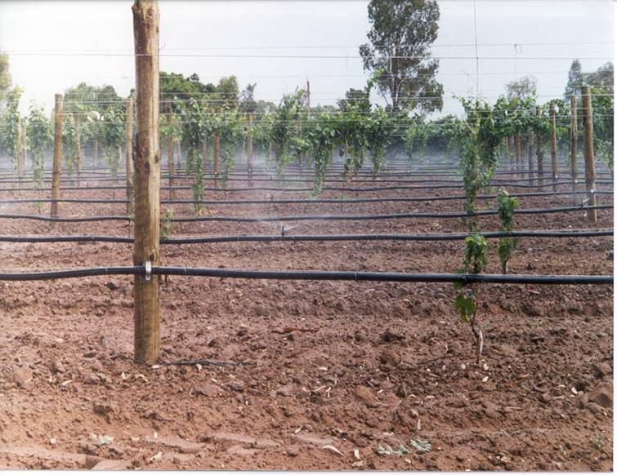
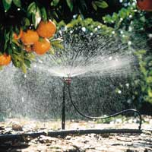
Microjets

Slide 6
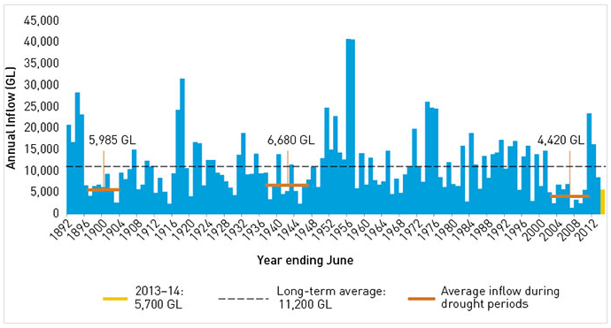
Annual inflows to the River Murray system since 1892 (modelled current conditions, including inflows to Menindee Lakes, but excluding Snowy Mountains Scheme, inter-valley transfer and environmental water inflows)

Slide 7
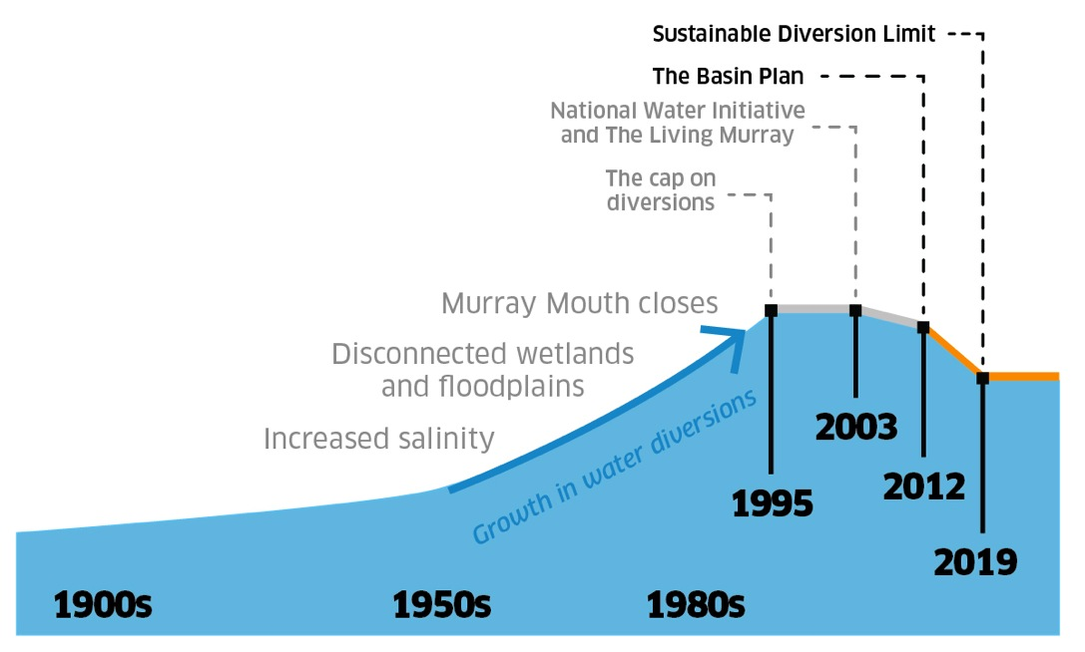
Water extraction and recovery

Slide 8
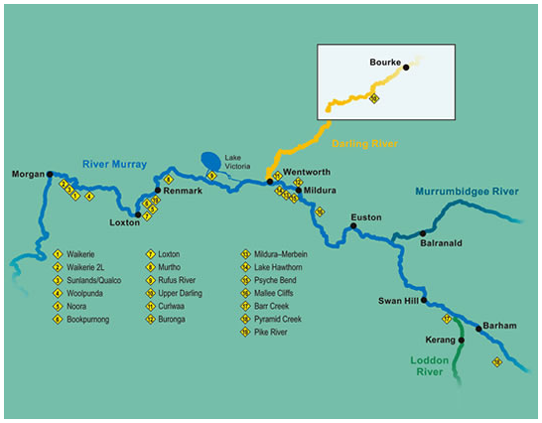
Woolpunda Pumps

Slide 9
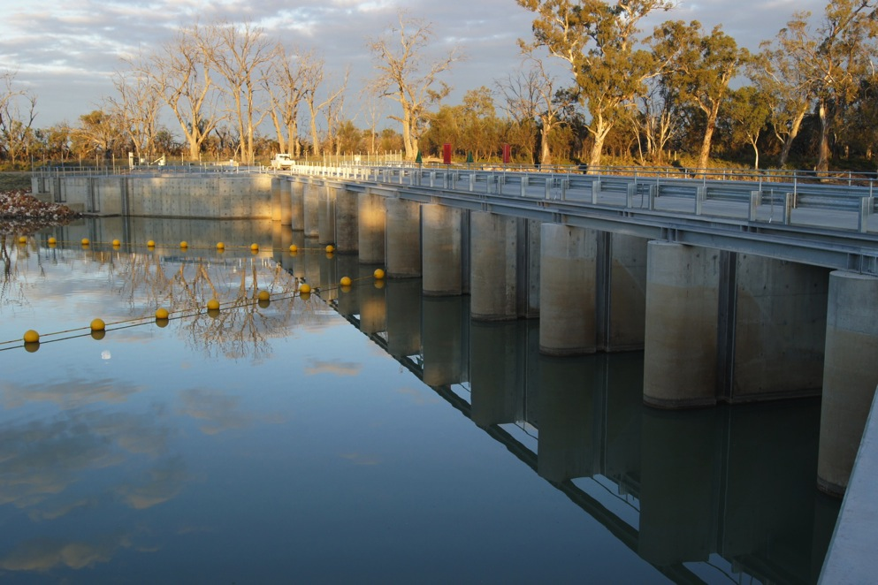
Chowilla
Regulator

Slide 10
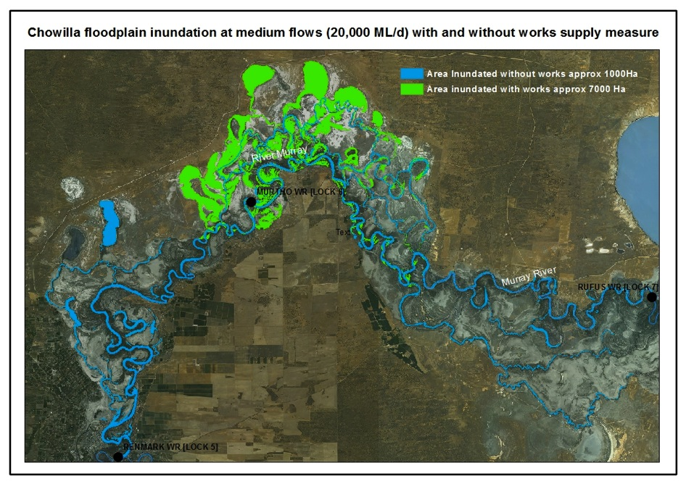
Environmental
Inundation

